Slide 1

DEEP Autoencoders
Dr. Amir Yavariabdi
1

Slide 2
Outline
Introduction to Unsupervised Learning
Mathematical Modeling
Reconstruction-based
Dimensionality Reduction Algorithms
Principle Component Analysis
Autoencoders
Types of Autoencoders
Applications of Autoencoders

Slide 3
Unsupervised Learning
Definition: Unsupervised learning is a machine learning approach where the model learns patterns and structures from unlabeled data without explicit supervision.
Two main methods dominate Unsupervised Learning:
Clustering and
Dimensionality Reduction.
To solve unsupervised learning problems, two main approaches are commonly utilized:
Mathematical Modeling
Reconstruction-Based

Slide 4
Unsupervised Learning: Mathematical Modeling
In this approach, unsupervised learning methods employ mathematical models to describe and understand the underlying structure of the data.
Examples of mathematical modeling techniques include:
Clustering algorithms such as K-means
Density-based clustering methods like DBSCAN
Probabilistic models such as Gaussian Mixture Models (GMM)
Dimensionality reduction techniques like Principal Component Analysis (PCA)

Slide 5
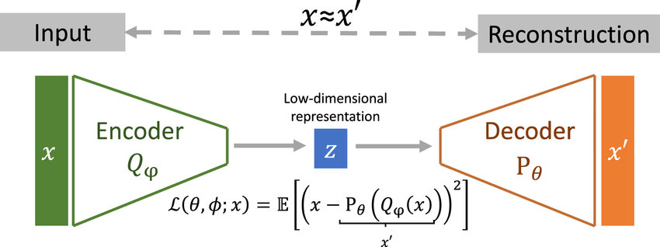
Unsupervised Learning: Reconstruction-based Approach
Reconstruction-based dimensionality reduction refers to a class of techniques that aim to reduce the dimensionality of a dataset by reconstructing the original data from a lower-dimensional representation.
Autoencoders are a popular type of neural network used for reconstruction-based dimensionality reduction.
Taken from: Y. Bozkurt et al., Interpretable embeddings from molecular simulations using Gaussian mixture variational autoencoders, 2020.

Slide 6
Dimensionality Reduction
Dimensionality reduction refers to the process of reducing the number of features or variables (dimensions) in a dataset while preserving the essential information.
Let’s assume we have a housing data with the following 5 features:
Size
Number of rooms
Number of bathrooms
Schools around
Crime rate
5 feature to 2 features
How do we this ideally?
We use dimensionality reduction algorithms
Size
Number of rooms
Number of bathrooms
Size feature
Schools around
Crime rate
Location feature

Slide 7
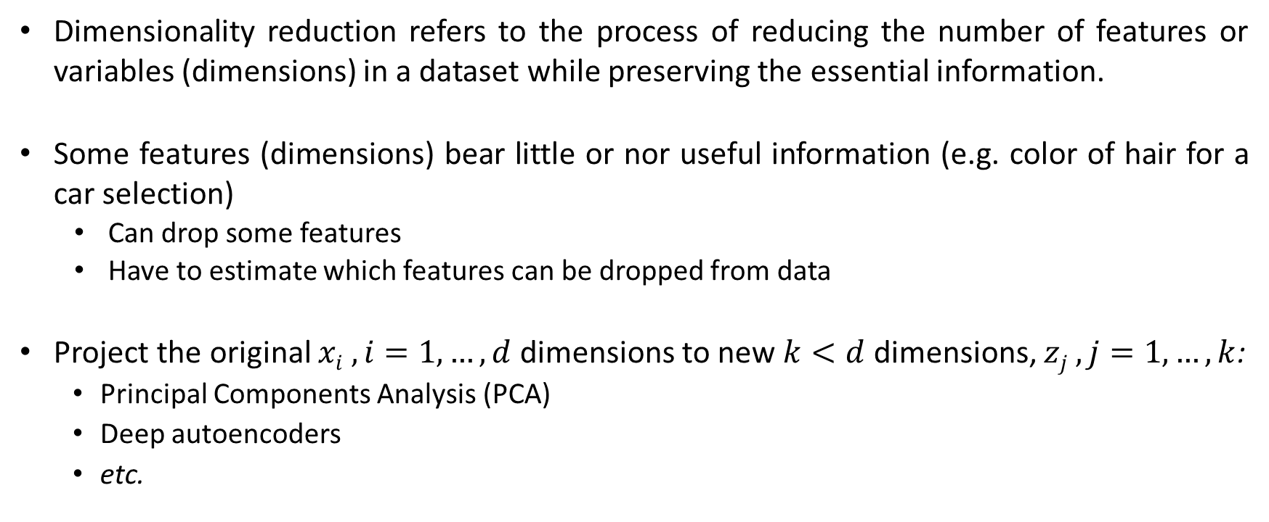
Dimensionality Reduction
Dimensionality reduction refers to the process of reducing the number of features or variables (dimensions) in a dataset while preserving the essential information.
Some features (dimensions) bear little or nor useful information (e.g. color of hair for a car selection)
Can drop some features
Have to estimate which features can be dropped from data
Project the original $xi , i=1,…,d$dimensions to new $k<d$ dimensions, $zj , j=1, …,k$:
Principal Components Analysis (PCA)
Deep autoencoders
etc.

Slide 8
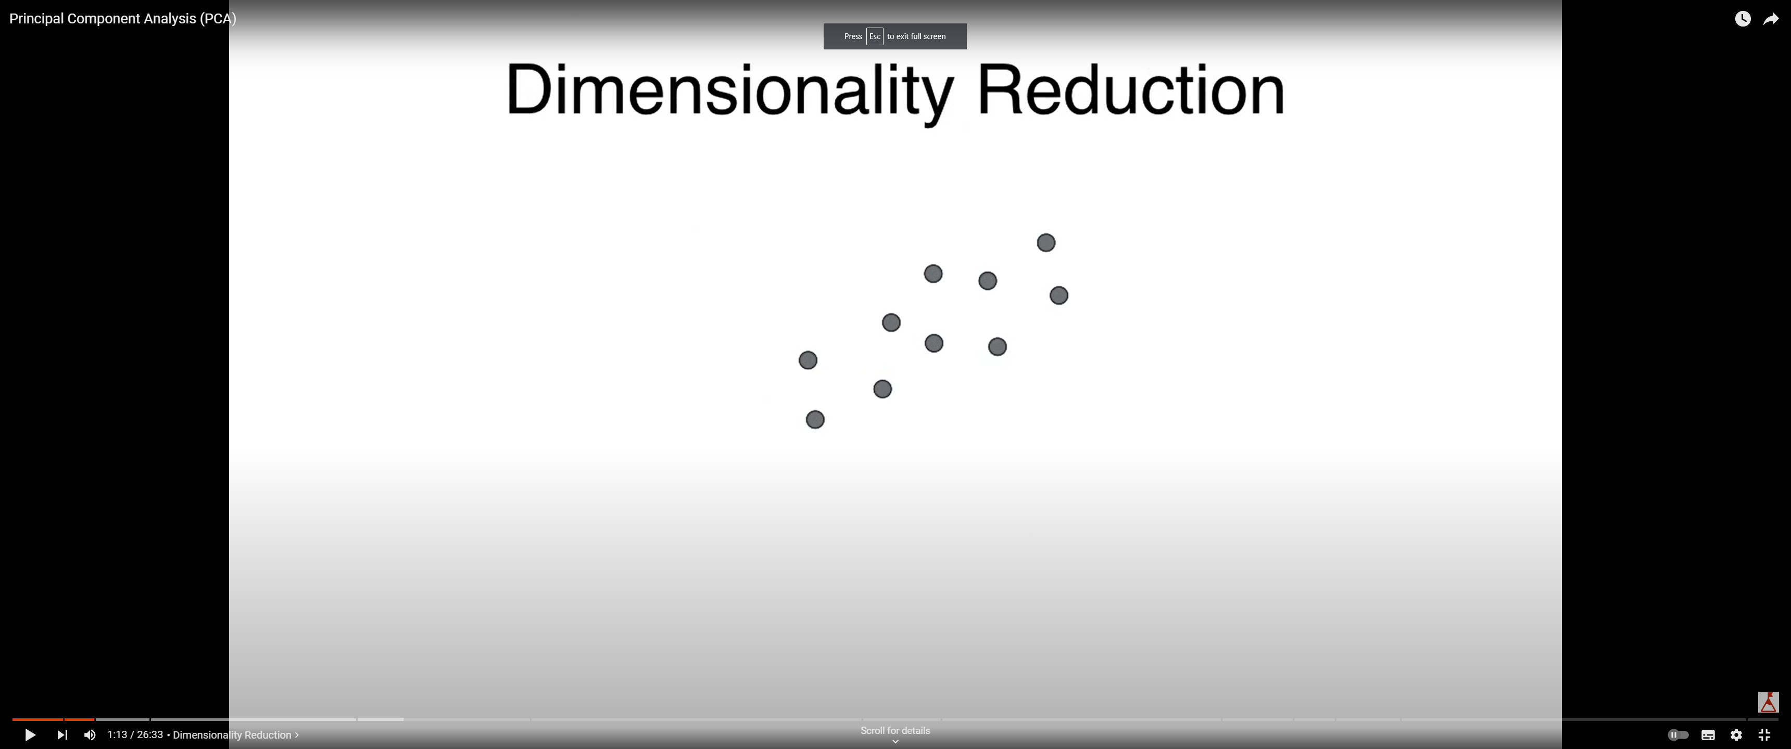
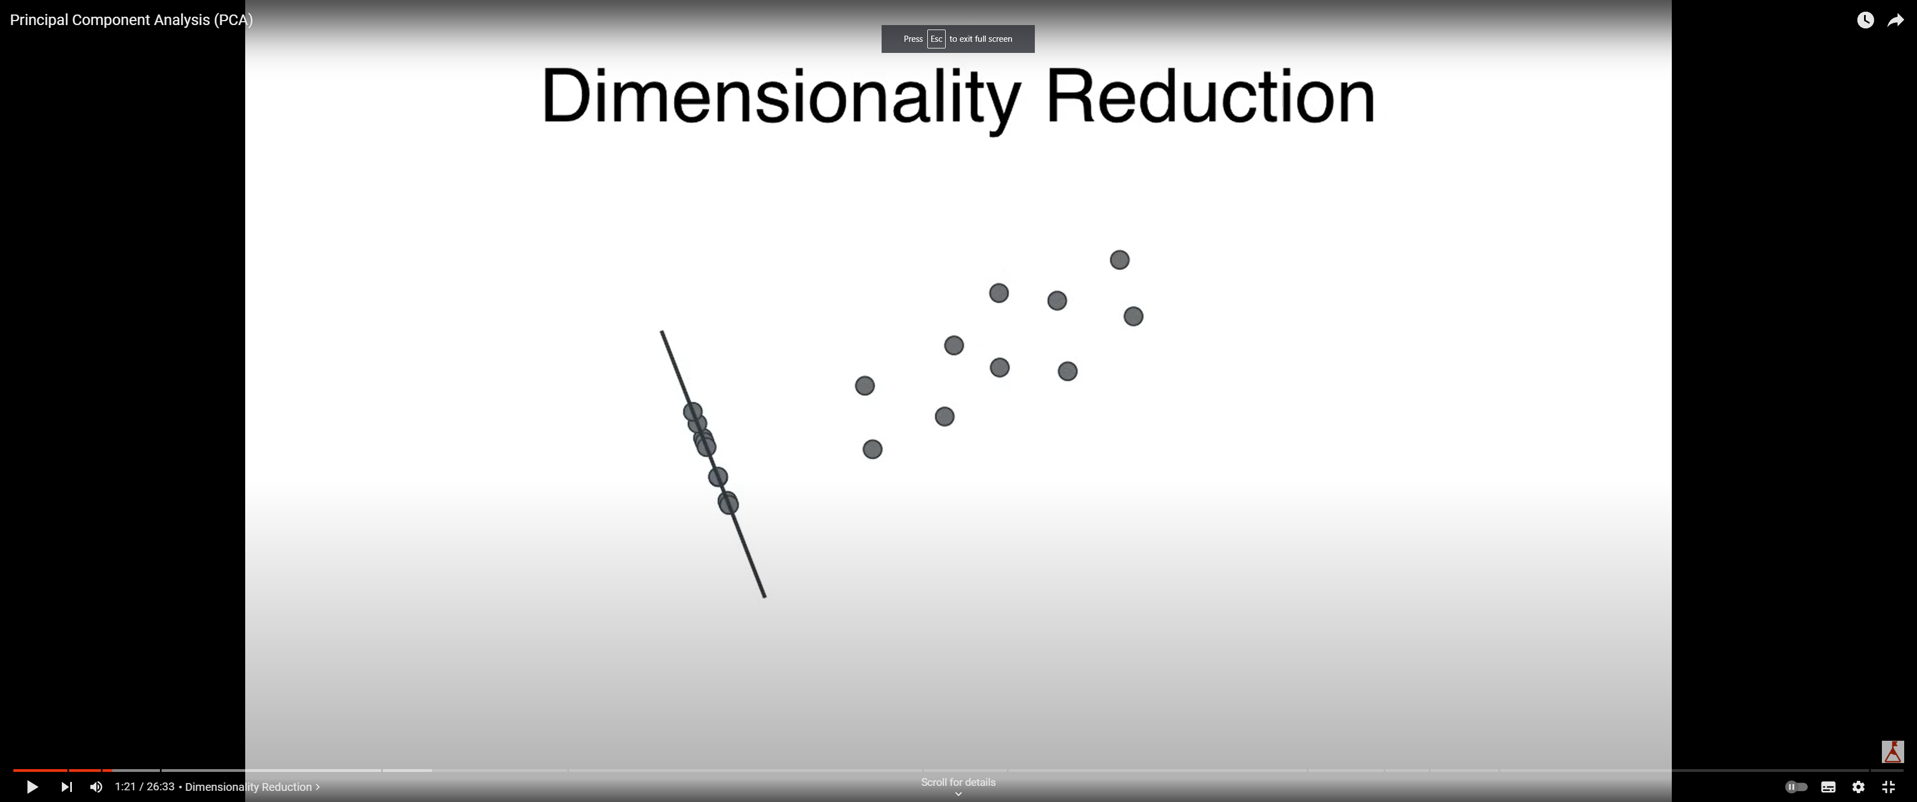
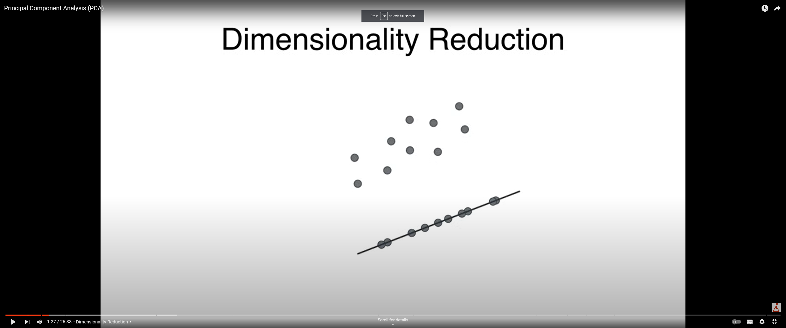
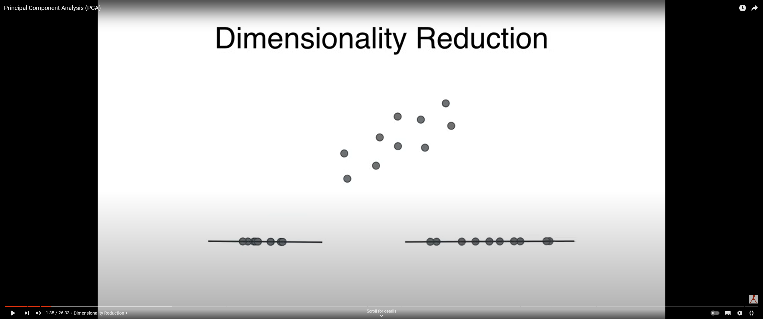
Principal Components Analysis
PCA preserves the most important patterns and structures in the data by capturing the directions along which the data varies the most.
This helps in simplifying the dataset while retaining its essential characteristics.
PCA preserves features with large variance, as they contain valuable information about the dataset.
Projection along axis 1
Projection along axis 2
2-D Data
First principal component
In this direction, the data varies the most

Slide 9
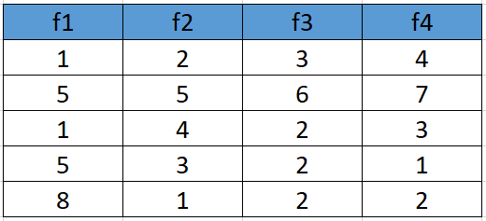
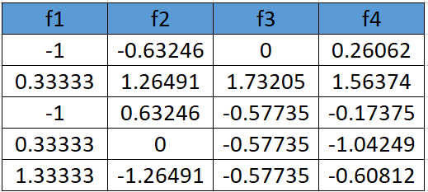
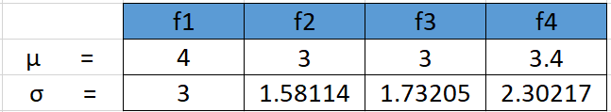
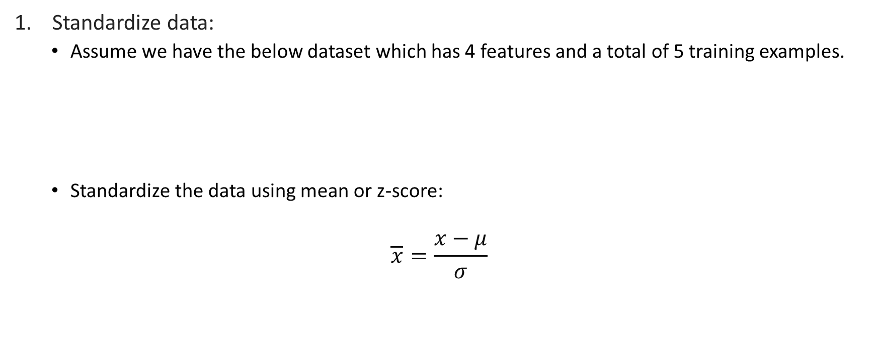
Principal Components Analysis: Steps
Standardize data:
Assume we have the below dataset which has 4 features and a total of 5 training examples.
Standardize the data using mean or z-score:
$$\overline{x}=\frac{x−μ}{σ}$$

Slide 10
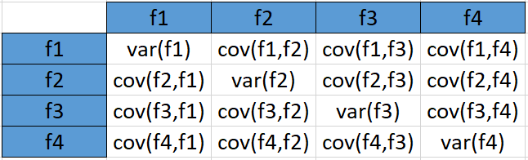
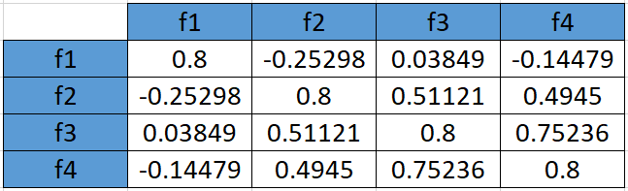
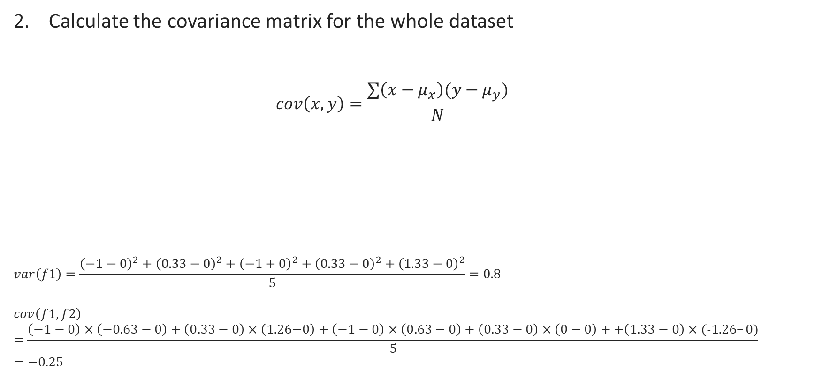
Principal Components Analysis: Steps
Calculate the covariance matrix for the whole dataset
$$cov\left(x,y\right)=\frac{∑\left(x−μ_{x}\right)(y−μ_{y})}{N}$$
$$var\left(f1\right)=\frac{{\left(−1−0\right)}^{2}+{\left(0.33−0\right)}^{2}+{\left(−1+0\right)}^{2}+{\left(0.33−0\right)}^{2}+{\left(1.33−0\right)}^{2}}{5}=0.8$$
$$cov\left(f1,f2\right)=\frac{\left(−1−0\right)×\left(−0.63−0\right)+\left(0.33−0\right)×\left(\text{1.26−0}\right)+\left(−1−0\right)×\left(0.63−0\right)+\left(0.33−0\right)×\left(0−0\right)++\left(1.33−0\right)×(−1.26–0)}{5}=−0.25$$
Since we have standardized the dataset, so the mean for each feature is 0 and the standard deviation is 1.
how pairs of features vary together

Slide 11
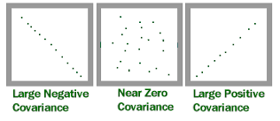
Principal Components Analysis: Steps
no relationship between the two variables
Interpreting variance and covariance in PCA:
Low variance
It means that the feature does change not much across the dataset.
The feature does not provide much information for distinguishing between different data points.
In the context of PCA, low variance features are less informative and may be candidates for merging with other features.
Large covariance
Large covariance indicates a strong linear relationship between the two features. If one feature increases, the other tends to increase as well, and vice versa.
Large covariance between features suggests a strong relationship or similarity in their patterns of variation.
If two features have highly similar patterns of variation and provide redundant information, keeping both features may not be necessary.
In PCA, large covariance between features might lead to the identification of redundant features that can be merged to simplify the dataset.

Slide 12

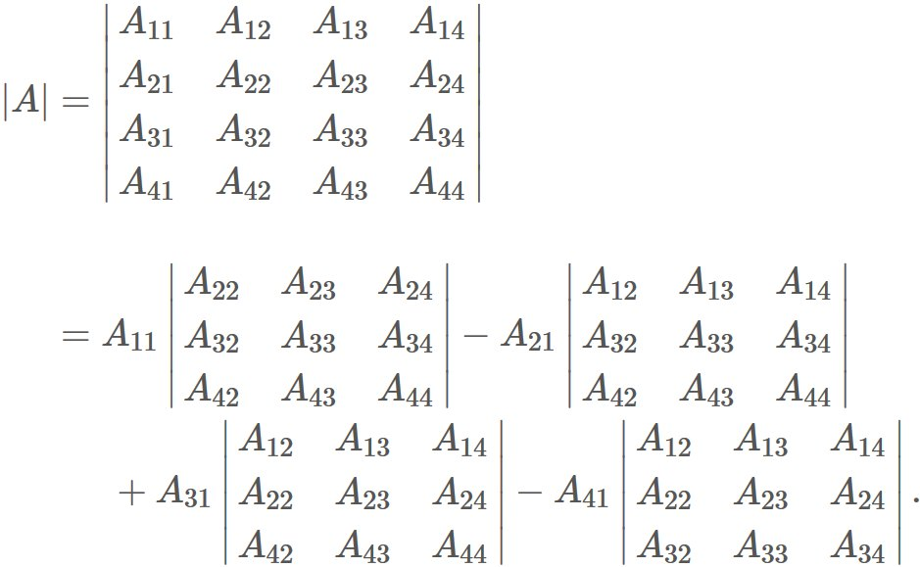
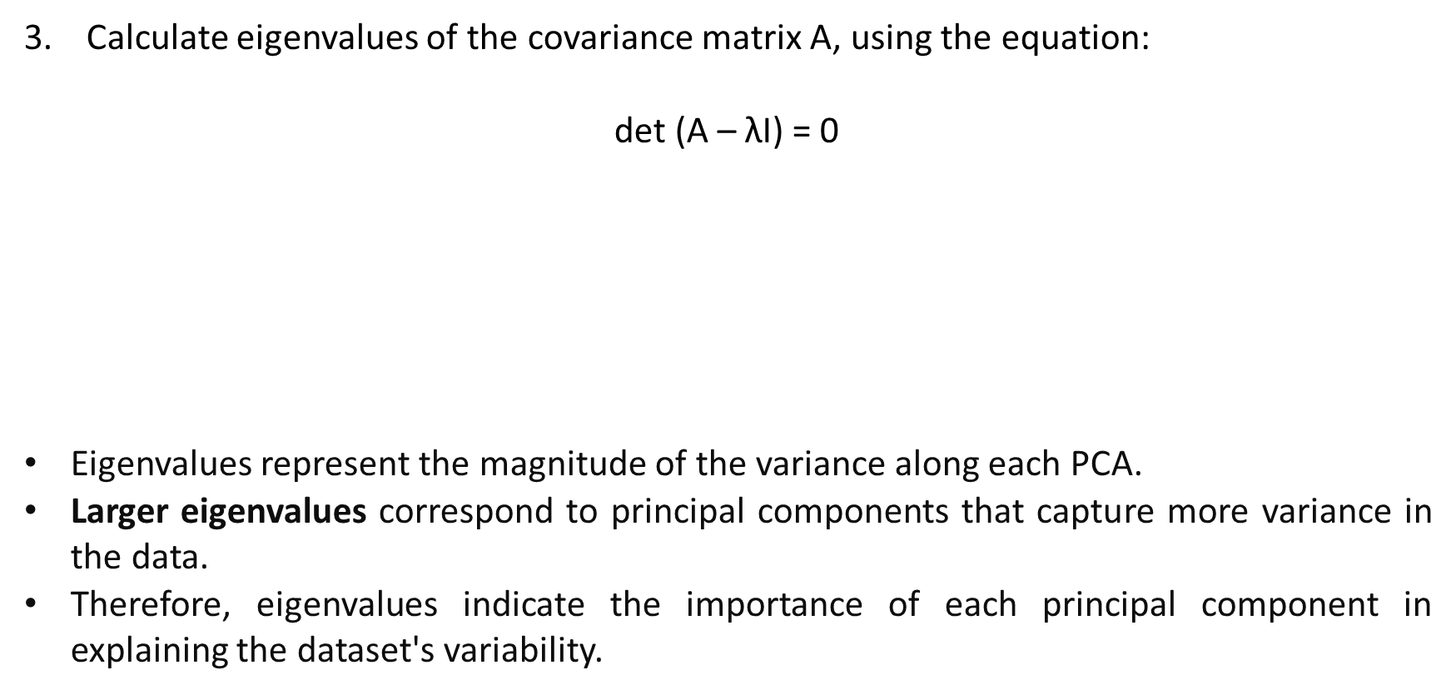
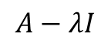
Principal Components Analysis: Steps
Calculate eigenvalues of the covariance matrix A, using the equation:
$$\text{det}\text{ (}\text{A}\text{ – }\text{λI}\text{)}\text{ =} \text{0}$$
Eigenvalues represent the magnitude of the variance along each PCA.
Larger eigenvalues correspond to principal components that capture more variance in the data.
Therefore, eigenvalues indicate the importance of each principal component in explaining the dataset's variability.
$$A−λI$$
Sorted eigenvalues
$$\text{λ}\text{ = }\text{2.51579324}\text{ , 1.0652885 , 0.39388704 , 0.02503121}$$

Slide 13
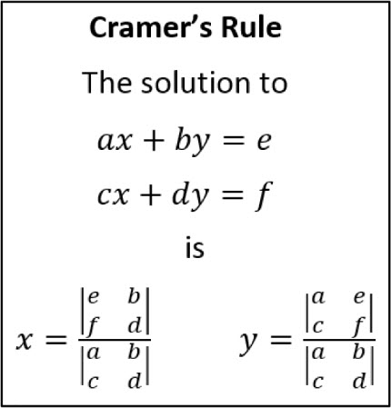
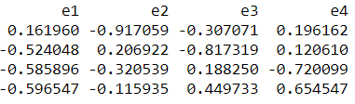
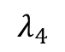
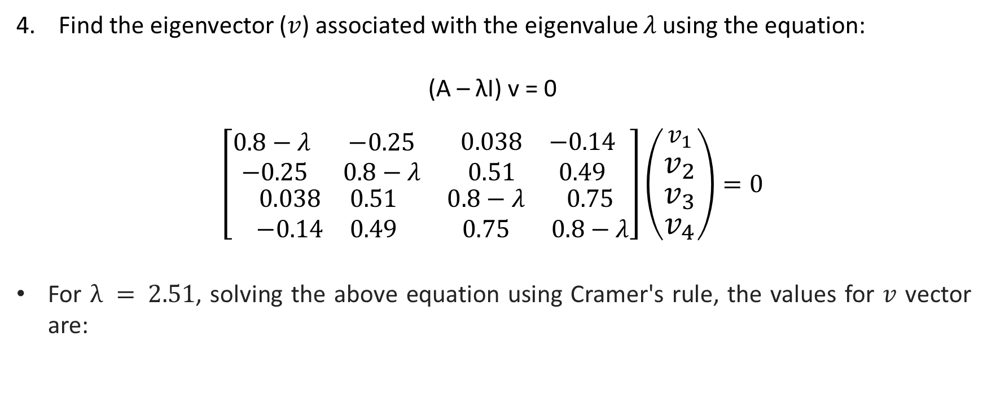
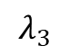
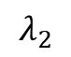
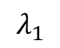
Principal Components Analysis: Steps
Find the eigenvector ($v$) associated with the eigenvalue $λ$ using the equation:
$$\text{(}\text{A}\text{ – }\text{λ}\text{I}\text{) }\text{v}\text{ = 0}$$
$$\left[\begin{matrix}\begin{matrix}0.8−λ & −0.25 \\ −0.25 & 0.8−λ\end{matrix} & \begin{matrix}0.038 & −0.14 \\ 0.51 & 0.49\end{matrix} \\ \begin{matrix}0.038 & 0.51 \\ −0.14 & 0.49\end{matrix} & \begin{matrix}0.8−λ & 0.75 \\ 0.75 & 0.8−λ\end{matrix}\end{matrix}\right]\left(\begin{aligned}v_{1} \\ v_{2} \\ v_{3} \\ v_{4}\end{aligned}\right)=0$$
For $λ = 2.51$, solving the above equation using Cramer's rule, the values for $v$ vector are:
Reminder
v1 = 0.16195986 v2 = -0.52404813 v3 = -0.58589647 v4 = -0.59654663
$$λ_{1}$$
$$λ_{2}$$
$$λ_{3}$$
$$λ_{4}$$
Eigenvectors represent the direction of each principal component axis in the feature space.

Slide 14
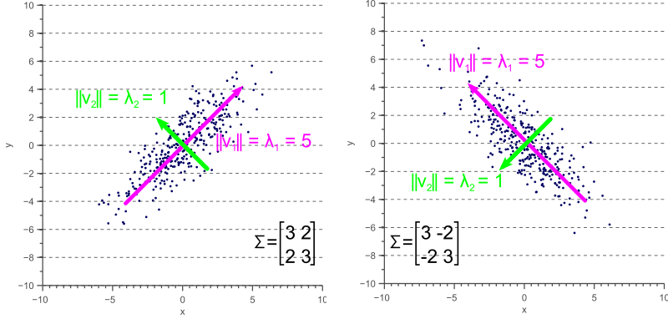
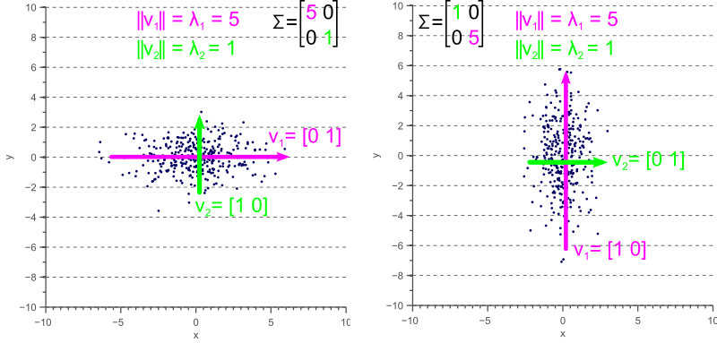
Eigenvalues and Eigenvectors
The eigenvalues in this case represent the magnitude of the spread in the direction of the principal components.

Slide 15
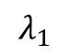
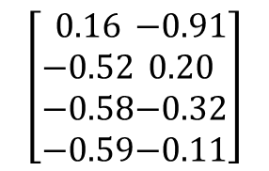
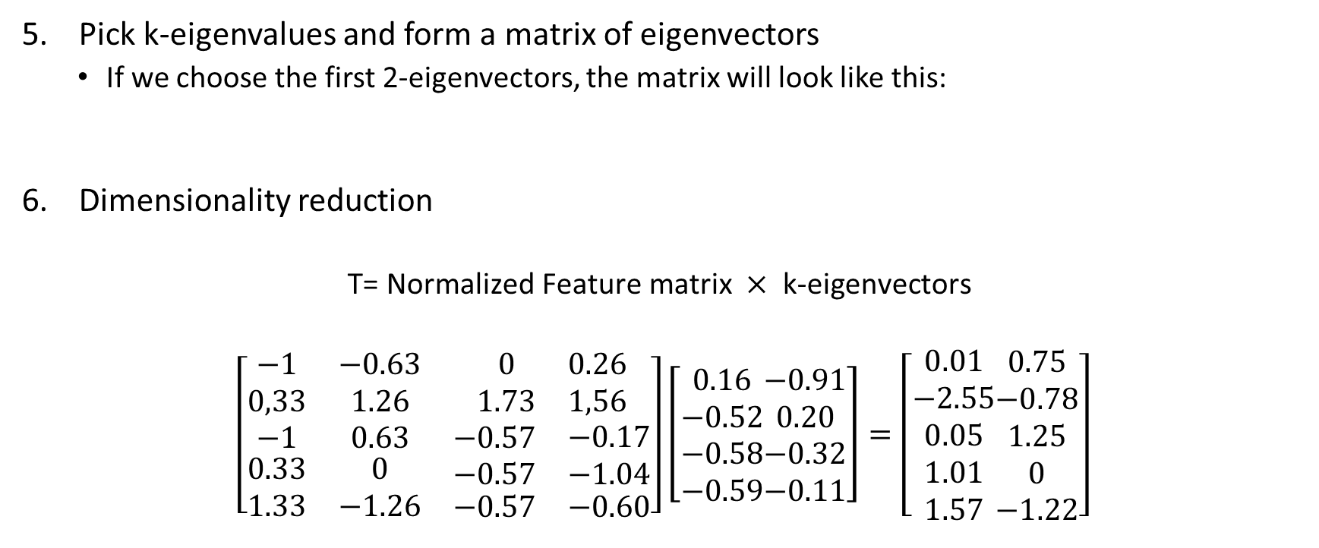
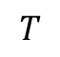
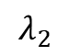
Principal Components Analysis: Steps
Pick k-eigenvalues and form a matrix of eigenvectors
If we choose the first 2-eigenvectors, the matrix will look like this:
Dimensionality reduction
$$\text{T}\text{= }\text{Normalized} \text{Feature} \text{matrix} × \text{k}\text{−}\text{eigenvectors}$$
$$\left[\begin{matrix}\begin{matrix}−1 & −0.63 \\ 0,33 & 1.26\end{matrix} & \begin{matrix}0 & 0.26 \\ 1.73 & 1,56\end{matrix} \\ \begin{matrix}−1 & 0.63 \\ \begin{aligned}0.33 \\ 1.33\end{aligned} & \begin{aligned}0 \\ −1.26\end{aligned}\end{matrix} & \begin{matrix}\begin{aligned}−0.57 \\ −0.57\end{aligned} & \begin{aligned}−0.17 \\ −1.04\end{aligned} \\ −0.57 & −0.60\end{matrix}\end{matrix}\right]\left[\begin{aligned}0.16 \\ −0.52 \\ −0.58 \\ −0.59\end{aligned}\begin{aligned}−0.91 \\ 0.20 \\ −0.32 \\ −0.11\end{aligned}\right]=\left[\begin{aligned}0.01 \\ −2.55 \\ 0.05 \\ 1.01 \\ 1.57\end{aligned}\begin{aligned}0.75 \\ −0.78 \\ 1.25 \\ 0 \\ −1.22\end{aligned}\right]$$
$$λ_{1}$$
$$λ_{2}$$
$$\left[\begin{aligned}0.16 \\ −0.52 \\ −0.58 \\ −0.59\end{aligned}\begin{aligned}−0.91 \\ 0.20 \\ −0.32 \\ −0.11\end{aligned}\right]$$
$$T$$

Slide 16
From PCA Challenges to Autoencoder Solutions
Problems with PCA and why one might consider using an autoencoder instead:
Linear Transformation:
Problem: PCA performs a linear transformation to find orthogonal linear combinations of features to capture maximum variance. It may struggle with nonlinear data.
Solution: Autoencoders are neural network models that can capture nonlinear relationships using deep architectures and hierarchical representations.
Loss of Information:
Problem: PCA can lead to information loss, especially with nonlinear data structures or important low-variance features.
Solution: Autoencoders minimize reconstruction error, preserving more information during dimensionality reduction.
Limited Representation Learning:
Problem: PCA may not capture meaningful features in high-dimensional data.
Solution: Autoencoders learn rich representations, making them suitable for complex feature and pattern learning tasks.

Slide 17
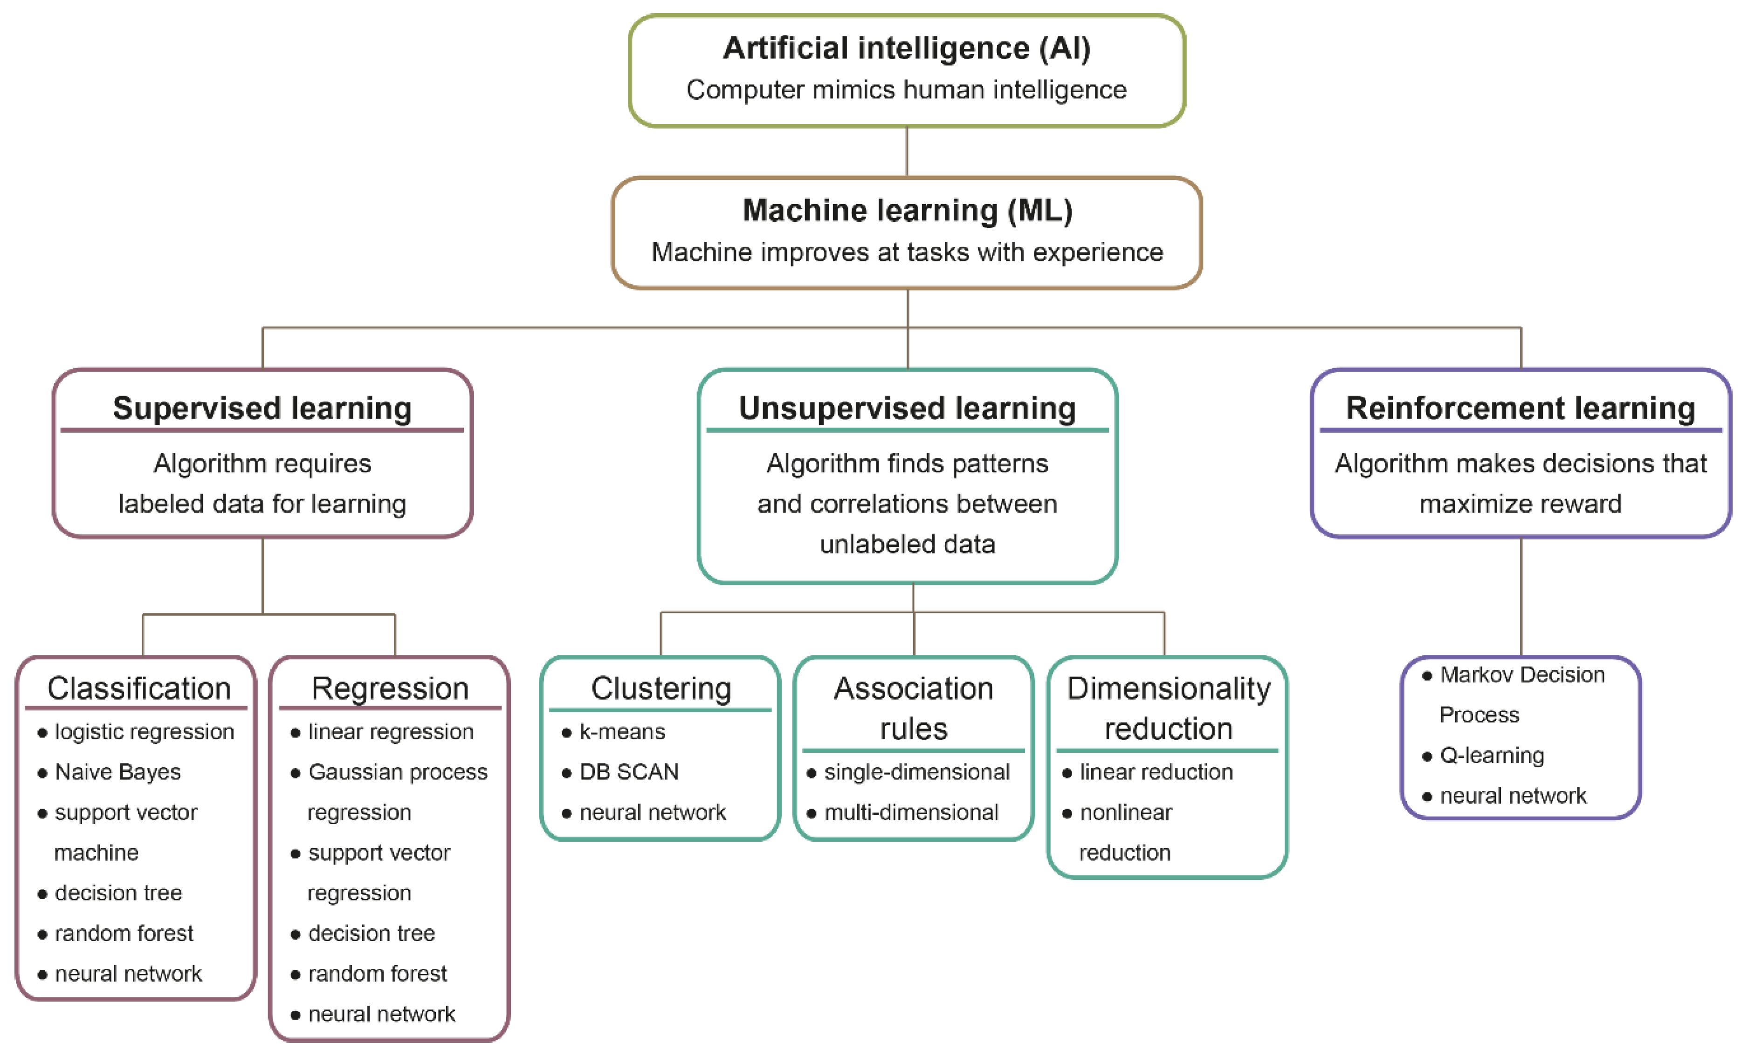
Introduction to Deep Autoencoders
Definition: An autoencoder is a type of artificial neural network used for
Clustering and
dimensionality reduction.
Taken from: O. Koteluk et al., How Do Machines Learn? Artificial Intelligence as a New Era in Medicine.

Slide 18
Understanding Autoencoders: Definition and Architecture
Autoencoders are an encoder-decoder neural network architecture used for unsupervised learning and dimensionality reduction.
Encoder: it maps the input data to a lower-dimensional.
Decoder: it reconstructs the original input data from this encoding.
Learning via Reconstruction Error:
The model aims to minimize the difference between the input data and the reconstructed output during training.
Reconstructed
Input
Input
Compressed
Input
300
150
20
150
300
Encoder
Decoder

Slide 19
Understanding Autoencoders: Aims
Purpose of Autoencoders:
The primary goal of autoencoders is to learn a compact representation of the input data that captures essential features and patterns.
They do so without requiring explicit labels or supervision, making them suitable for unsupervised learning tasks.
Reconstructed
Input
Input
Compressed
Input
300
150
20
150
300
Encoder
Decoder

Slide 20
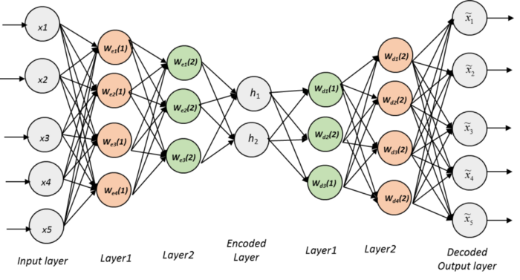
Autoencoders: Encoders
The encoder is a fundamental part of the autoencoder architecture, responsible for compressing the input data into a lower-dimensional representation.
Input Data Transformation:
The encoder takes input data, such as images, sequences, or numerical features, as its input.
It applies a series of transformations, typically through layers of neural network units, to map the input data to a compact representation.
Feature Extraction:
During the encoding process, the encoder learns to extract important features and patterns from the input data.
Each layer in the encoder captures different levels of abstraction, allowing it to capture both low-level and high-level features.

Slide 21
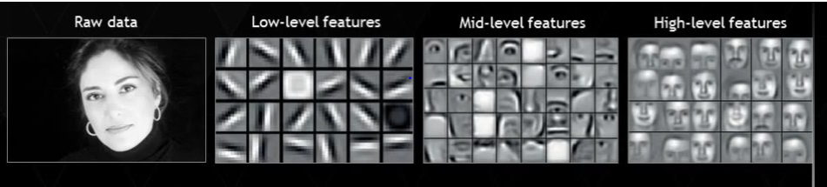
Autoencoders: Encoders
Low-level features and high-level features refer to different levels of abstraction in data representations
Low-Level Features:
Low-level features are basic and primitive attributes or characteristics of the data.
These features typically represent simple and local patterns or properties of the data.
Examples of low-level features depend on the type of data being analyzed:
In image data, low-level features could include edges, corners, or lines.
In text data, low-level features might include individual words, characters, punctuation, or basic grammatical structures.
In numerical data, low-level features could be individual data points, basic statistics (mean, variance), or simple patterns.

Slide 22
Autoencoders: Encoders
Low-level features and high-level features refer to different levels of abstraction in data representations
High-Level Features:
High-level features are more abstract and complex representations derived from combinations of low-level features.
These features capture more global or semantic information and higher-order patterns in the data.
High-level features are often formed by aggregating or transforming low-level features through hierarchical processing.
Examples of high-level features:
In image data, high-level features could represent objects, shapes, textures, or semantic concepts (e.g., "face," "tree," "car").
In text data, high-level features might represent topics, sentiments, relationships between words, or semantic meanings.
In numerical data, high-level features could capture relationships between variables, clusters of related data points, or patterns indicative of specific behaviors or phenomena.

Slide 23
Autoencoders: Encoders
Low-level features and high-level features refer to different levels of abstraction in data representations
High-Level Features:
High-level features are more abstract and complex representations derived from combinations of low-level features.
These features capture more global or semantic information and higher-order patterns in the data.
High-level features are often formed by aggregating or transforming low-level features through hierarchical processing.
Examples of high-level features:
In image data, high-level features could represent objects, shapes, textures, or semantic concepts (e.g., "face," "tree," "car").

Slide 24
Autoencoders: Encoders
Dimensionality Reduction:
One of the key objectives of the encoder is to reduce the dimensionality of the input data.
By representing the data in a lower-dimensional space, the encoder creates a compressed representation that keeps essential information while discarding redundant or less informative features.
Latent Space Representation:
The output of the encoder, known as bottleneck layer, is often referred to as the latent space representation or encoding.
This encoding captures a condensed and meaningful representation of the input data, which can be used for various tasks such as
reconstruction,
feature learning, or
downstream analysis.

Slide 25
Autoencoders: Decoder
The decoder takes the encoded representation (latent space embedding) from the bottleneck layer or latent space of the autoencoder as its input.
It performs the reverse process of the encoder, transforming the encoded data back into the input domain.
Similar to the encoder, the decoder typically consists of multiple dense layers.
These layers decode the latent representation step by step to generate the reconstructed output.

Slide 26
Autoencoders: Decoder
The decoder's layers gradually generate features and details required to reconstruct the input data.
It aims to recover as much information as possible from the compressed representation while minimizing reconstruction errors.
The final layer of the decoder produces the reconstructed output that should ideally closely match the original input data.
The quality of reconstruction is evaluated using metrics such as Mean Squared Error (MSE) or other appropriate loss functions.

Slide 27
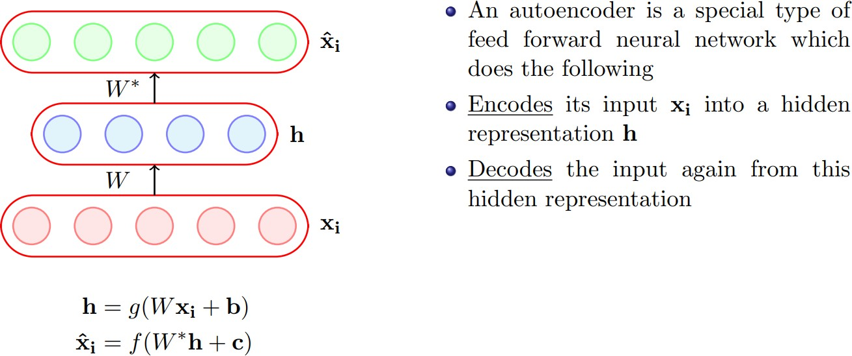
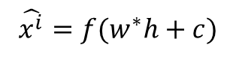
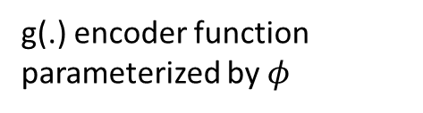
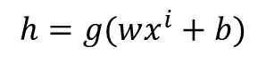
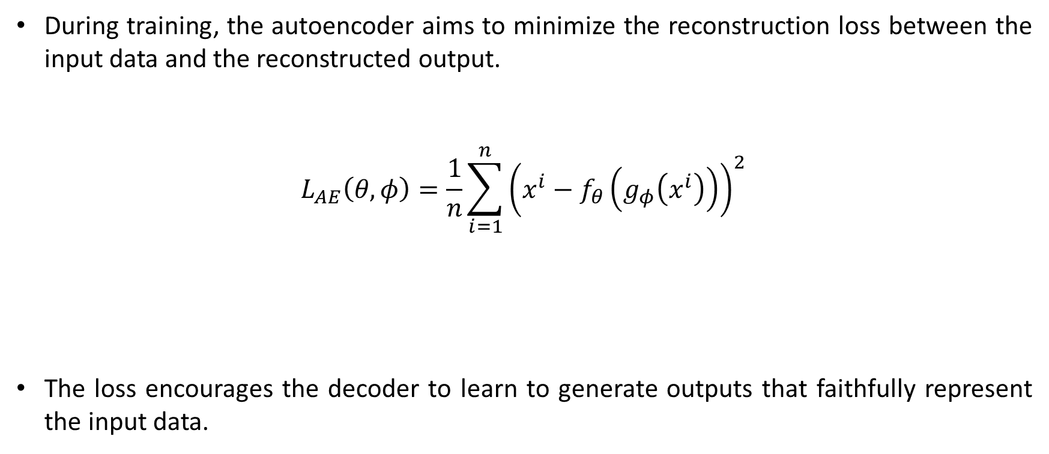
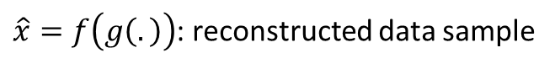
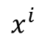
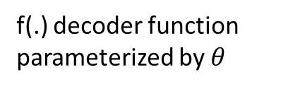
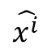
Autoencoders: Loss Function
During training, the autoencoder aims to minimize the reconstruction loss between the input data and the reconstructed output.
$$L_{AE}\left(θ,φ\right)=\frac{1}{n}\sum_{i=1}^{n}{{\left(x^{i}−f_{θ}\left(g_{φ}\left(x^{i}\right)\right)\right)}^{2}}$$
The loss encourages the decoder to learn to generate outputs that faithfully represent the input data.
f(.) decoder function parameterized by $θ$
$$\hat{x^{i}}$$
g(.) encoder function parameterized by $φ$
$$x^{i}$$
$$h=g(wx^{i}+b)$$
$\hat{x}=f\left(g\left(.\right)\right)$: reconstructed data sample
$$\hat{x^{i}}=f(w^{∗}h+c)$$

Slide 28
Autoencoders: Hyperparameters
Number of Layers:
The depth of the encoder refers to the number of hidden layers it contains.
Deeper architectures can capture more complex features but may require more computational resources and training time.
Number of Neurons per Layer:
The number of neurons in each hidden layer of the encoder determines the capacity and expressiveness of the model.
Larger numbers of neurons can capture more details but may increase the risk of overfitting, especially with limited training data.
Activation Functions in Hidden Layers:
Activation functions such as ReLU (Rectified Linear Unit), Sigmoid, or Tanh can be applied to the output of each neuron in the hidden layers.
The choice of activation functions affects the model's ability to learn nonlinear relationships and can impact training stability.

Slide 29
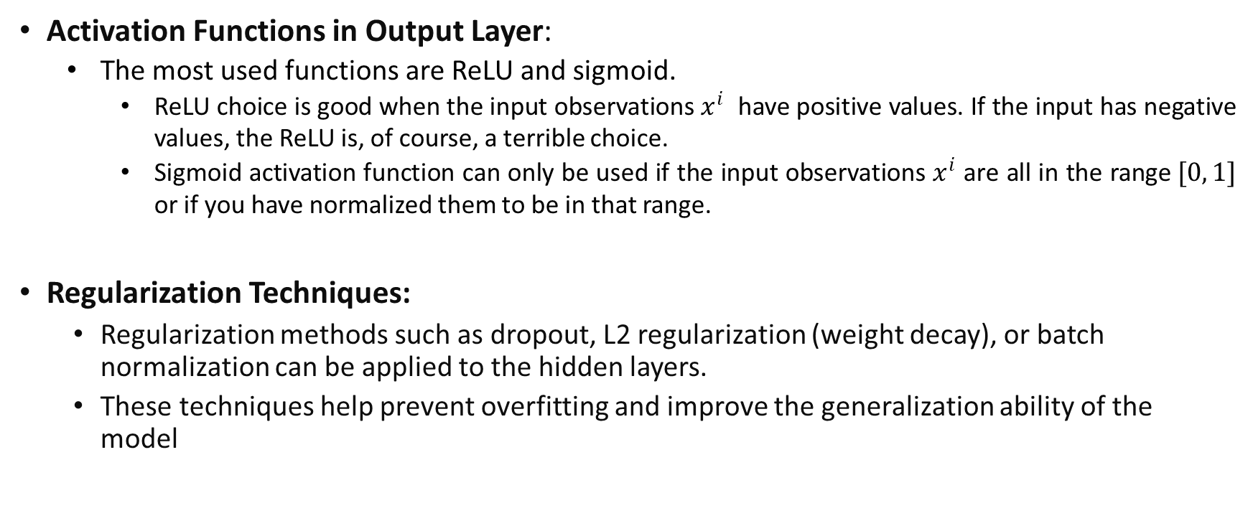
Autoencoders: Hyperparameters
Activation Functions in Output Layer:
The most used functions are ReLU and sigmoid.
ReLU choice is good when the input observations $x^{i}$ have positive values. If the input has negative values, the ReLU is, of course, a terrible choice.
Sigmoid activation function can only be used if the input observations $x^{i}$ are all in the range $[0, 1]$ or if you have normalized them to be in that range.
Regularization Techniques:
Regularization methods such as dropout, L2 regularization (weight decay), or batch normalization can be applied to the hidden layers.
These techniques help prevent overfitting and improve the generalization ability of the model

Slide 30
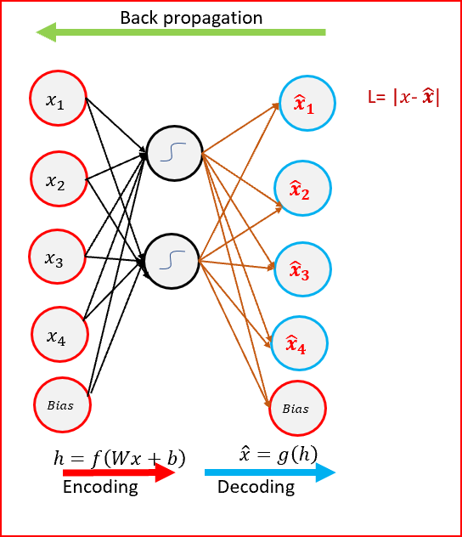
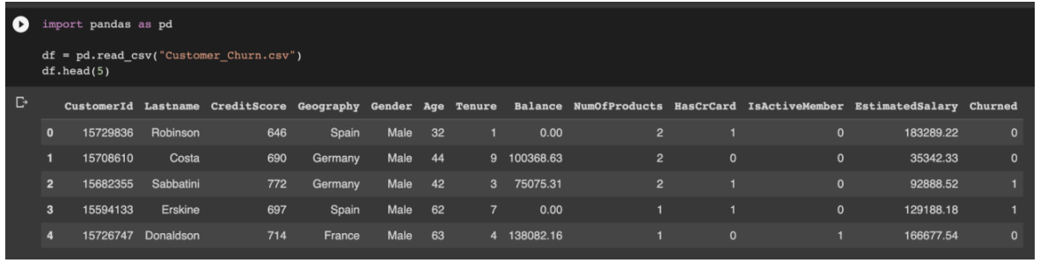
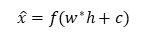
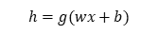
Autoencoders: Example and Steps
Pre-process Raw Data: Take the first row from the customer data in an array as the input.
Dropping Unnecessary Variables
Dummy-encode Categorical Variables
Scaling the Data
Fitting an AutoEncoder Architecture
Step 1
$$h=g(wx+b)$$
$$\hat{x}=f(w^{∗}h+c)$$

Slide 31
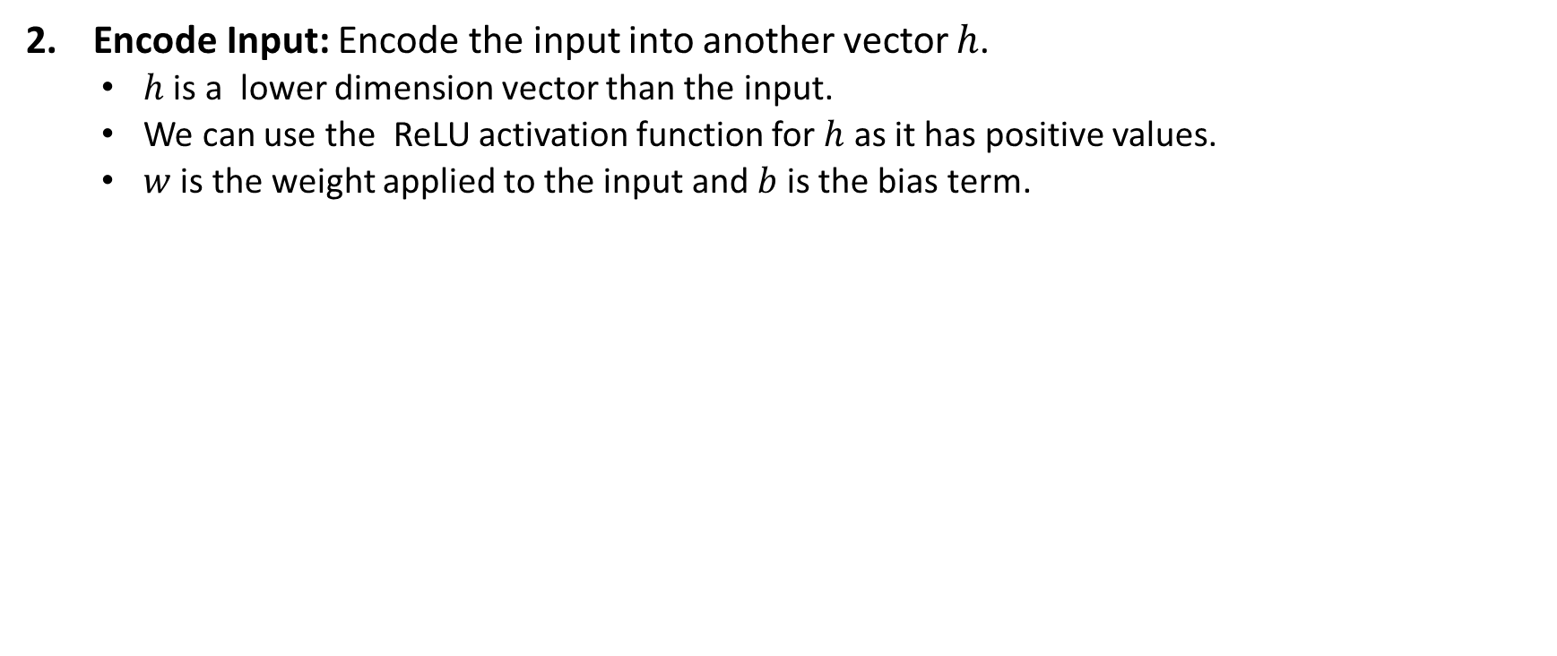
Autoencoders: Example and Steps
Encode Input: Encode the input into another vector $h$.
$h$ is a lower dimension vector than the input.
We can use the ReLU activation function for $h$ as it has positive values.
$w$ is the weight applied to the input and $b$ is the bias term.
Step 1
$$h=g(wx+b)$$
$$\hat{x}=f(w^{∗}h+c)$$
Step 2

Slide 32
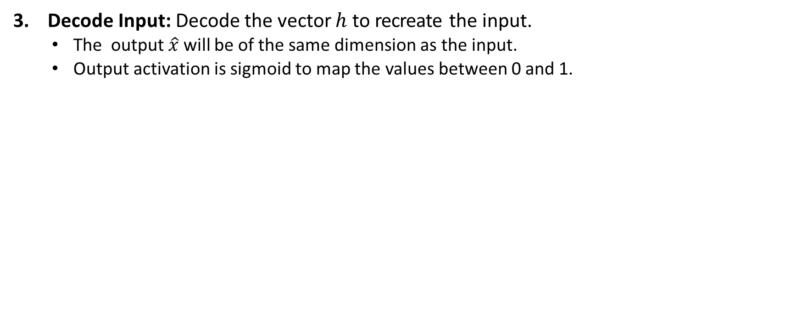
Autoencoders: Example and Steps
Decode Input: Decode the vector $h$ to recreate the input.
The output $\hat{x}$ will be of the same dimension as the input.
Output activation is sigmoid to map the values between 0 and 1.
Step 1
$$h=g(wx+b)$$
$$\hat{x}=f(w^{∗}h+c)$$
Step 2
Step 3

Slide 33
Autoencoders: Example and Steps
Reconstruction Error: Calculate the reconstruction error L.
Reconstruction error is the difference between the input and output vector.
Our goal is to minimize the reconstruction error so that output is similar to the input vector.
Step 4
Step 1
$$h=g(wx+b)$$
$$\hat{x}=f(w^{∗}h+c)$$
Step 2
Step 3

Slide 34
Autoencoders: Example and Steps
Backpropagation: Back propagate the error from the output layer to the input layer to update the weights.
Weights are updated based on how much they were responsible for the error.
Repeat steps 1 through 5 for each of the observations in the dataset.
Weights are updated after each observation (Stochastic Gradient descent).
Repeat more epochs.
One epoch is over when all the rows in the data have passed through the neural network.
Step 5
Step 4
Step 1
$$h=g(wx+b)$$
$$\hat{x}=f(w^{∗}h+c)$$
Step 2
Step 3

Slide 35

Types of Autoencoders
Depending on the number of neurons in the hidden layers, there are two types of autoencoders:
undercomplete, and
overcomplete.

Slide 36
Undercomplete Autoencoders
It is one of the most common types of autoencoders.
An undercomplete autoencoder is a type of autoencoder where the dimensionality of the latent space (bottleneck layer) is lower than the dimensionality of the input data.
Learning to compress high dimensional input into lower dimensional representation forces network to capture only the most important features.
Challenges:
Balancing Compression and Reconstruction Quality: The challenge lies in finding a balance between high compression (small latent space) and maintaining sufficient information for accurate reconstruction.
Overfitting: Undercomplete autoencoders can be prone to overfitting, especially if the latent space is too small relative to the complexity of the data.

Slide 37
Overcomplete Autoencoders
Overcomplete autoencoders are a variant of traditional autoencoders where the dimensionality of the latent space (encoding) is larger than the input dimension.
It gives the possibility of learning greater number of features.
With more degrees of freedom, overcomplete autoencoders can capture fine-grained details and subtle patterns in the data.
Applications and Use Cases:
They are used in tasks where capturing intricate details or diverse features is crucial, such as image generation, signal denoising, and high-dimensional data analysis.
They are also applied in feature learning scenarios to explore the full potential of the representation space.

Slide 38
Types of Autoencoders
Here are some popular Autoencoders:
Denoising Autoencoder
A type of autoencoder trained to reconstruct clean inputs from noisy or corrupted versions, helping to learn robust representations.
Sparse Autoencoder
An autoencoder designed to learn sparse representations, where only a subset of neurons in the latent space is activated for each input, aiding in feature selection and interpretability.
Contractive Autoencoder
An autoencoder trained with an additional penalty term to enforce stability and robustness against small variations in input, promoting the learning of invariant features.
Variational Autoencoder (used for generative modeling)
A probabilistic autoencoder that models the latent space as a probability distribution, enabling generation of new data samples and latent space interpolation for generative modeling tasks.

Slide 39

Autoencoders: Applications
Grayscale to Color Conversion: Autoencoders can be trained to convert grayscale images to colorized versions by learning the mapping between grayscale inputs and corresponding color images.

Slide 40

Autoencoders: Applications
Watermarks Removal: Autoencoders Remove Watermarks From The Input Image.

Slide 41

Autoencoders: Applications
Anomaly detection: Anomalies or outliers in the data are identified based on the reconstruction error, which measures the difference between the input data and its reconstruction.
Instances with significantly high reconstruction errors are considered anomalies or outliers.

Slide 42

Autoencoders: Applications
Recommendation systems: Recommendations can be made by identifying similar users or items in the latent space and recommending items that are relevant or preferred by similar users.
Map users and items into a latent space, capturing their preferences and characteristics
user-user similarity matrix
User-item interactions or ratings
item-item similarity matrix
Taken from: J. Barbieri et al., Autoencoders and recommender systems: COFILS approach

Slide 43


Autoencoders: Applications
Clustering: Autoencoders can be used for feature extraction in unsupervised learning scenarios, and the extracted features can then be combined with clustering algorithms for data clustering.
Taken from: Kamran Kowsari et al., Diagnosis of Celiac Disease and Environmental Enteropathy on Biopsy Images Using Color Balancing on Convolutional Neural Networks

Slide 44
References
Diederik P Kingma and Welling Max, An Introduction to Variational Autoencoders, Now Publishers, 2019.
Ankur A. Patel, Hands-On Unsupervised Learning using Python, O'Reilly, 2019.
Andrew Ng, Sparse autoencoder, CS294A Lecture notes

Slide 45
Thank you for listening

